Slide 1
CENTRAL NERVOUS SYSTEM-2

Slide 2
NERVOUS SYSIEM
CENTRAL NERVOUS SYSTEM PERIPHERAL NERVOUS SYSTEM
BRAIN SPINAL CORD AUTONOMIC SOMATIC
NERVOUS SYSTEM NERVOUS SYSTEM
SYMPATHETIC PARASYMPATHETIC
NERVOUS SYSTEM NERVOUS SYSTEM

Slide 3
BRAIN
FOREBRAIN MIDBRAIN HINDBRAIN
[PROSENCEPHALON] [MESENCEPHALON] [RHOMBENCEPHALON]
TELENCEPHALON DIENCEPHALON 1.Pons Medulla oblongata
1. Cerebrum 1. Thalamus 2.Cerebellum
2. Basal ganglion 2. Hypothalamus
3.Amygdala
4. Hippocampus

Slide 4
BRAIN
Form 3% of body weight and it weighs about 1.5 kg. Brain and spinal cord are covered by three coverings like pia mater, arachnoid mater and Dura mater. Subdural space between dura and arachnoid mater is filled with tissue fluid and Sub arachnoid space is filled with cerebrospinal fluid. Brain is divided into three regions
FORE BRAIN or PROSENCEPHALON
A. TELENCEPHALON or CEREBRUM
B. DIENCEPHALON --- THALAMUS, SUB THALAMUS [ RED NUCLEUS , SUBSTANTIA NIGRA & SUBTHALAMIC NUCLEUS], EPITHALAMUS [HABENULAR NUCLEUS & PINEAL GLAND]& HYPOTHALAMUS
2. MID BRAIN or MESENCEPHALON
3. HIND BRAIN or RHOMBENCEPHALON--- CEREBELLUM, PONS AND MEDULLA.
CEREBRUM
It form the largest part of brain. Surface is covered by 2-4 mm thick grey matter known as cerebral cortex. Cerebral hemisphere is divided into four lobes like Frontal[motor function], Parietal, Temporal[hearing] and occipital[vision]
There are two cerebral hemispheres like Right and Left. Left cerebral hemisphere[Categorical hemisphere] performs language related motor functions like speech, reading and writing etc. Right cerebral hemisphere[Representational hemisphere] performs functions like ability to appreciate music , artistic skills, stereo gnosis etc.

Slide 5
FUNCTIONS OF CEREBRUM
Help to interpret touch, speech, vision, hearing, reasoning, emotions, learning and fine control of movements.
THALAMUS
Receive senses [except smell] , regulate level of consciousness. Manage motor and cognitive functions
HYPOTHALAMUS
Regulate sleep, hunger and body temperature
HIPPOCAMPUS- Learning and memory
AMYGDALA- Control fear, memory, trigger sexual desire
BRAIN STEM-MID BRAIN ,PONS AND MEDULLA
Relays signals between brain and spinal cord and manage basic involuntary functions.
PONS- breathing rhythm
MEDULLA- Respiration, circulation, digestion, swallowing, coughing
MIDBRAIN- vision, hearing and motor control.
CEREBELLUM- maintain posture and balance

Slide 6
NEURON
Neuron is the structural and functional unit of nervous system. There are 100 million neurons in the body. Centromere is absent so it cannot divide.
STRUCTURE OF NEURON
It consist of cell body, dendrites and axon
CELL BODY
Also known as soma or perikaryon. It consists of nucleus, nissil bodies, neuro fibrils, mitochondrion and Golgi body. Nucleus is present in the central part of soma. It has one nucleolus and lack centromere so cannot divide.
NISSIL BODIES
Are small basophilic granules .They are present in soma but not present in axon hillock[part of soma where axon arises] extend into dendrites but not into axon. It contain ribosomes and synthesis proteins which are transported to axon by axon flow. When there is excess need as in work or fatigue, the Nissil granules overwork and disappear. This is known as Chromatolysis.
MITOCHONDRIA
Are present in soma and axon. It synthesis ATP.
GOLGI APPARATUS
Is similar to other cells. It is concerned with processing and packaging of proteins.

Slide 7
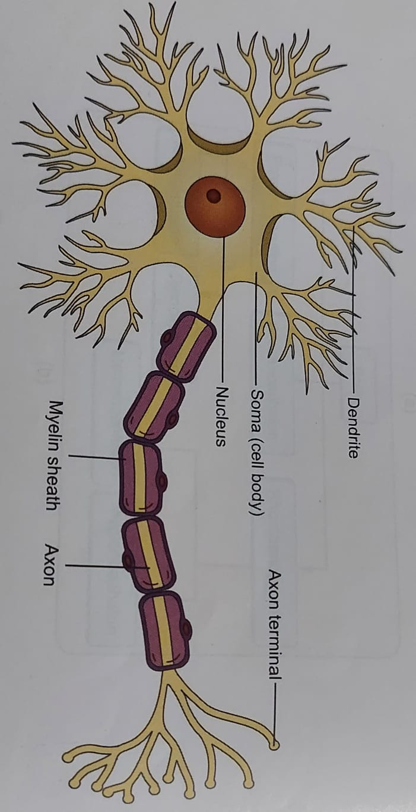
NEUROFIBRILS
Made of microfilaments and microtubules and are thread like structures present in soma and nerve processes
DENDRITE
It is a short process which has nissil granules and neurofibrils. It transmit impulse towards the cell body.
AXON
Is a long process which arise from axon hillock. First part of the axon is more excitable than other parts of the neuron. Many axons together form a bundle called fasciculus. Many fasciculi together form a nerve trunk. Each nerve fiber is covered by a perineurium. Each nerve trunk is covered by epineurium. Axon contains a central core of cytoplasm called axoplasm. It is covered by tubular sheath called axolemma. Axoplasm and axolemma together is called axon cylinder. It is covered by a membrane called neurilemma.

Slide 8
TYPES OF AXON[NERVE FIBER]
There are two types of axons
1. Myelinated
2. Non myelinated
MYELINATED AXONS
Axons are covered by myelin sheath which acts as an insulator. Myelin sheath is made of lipoprotein which is absent in specific regions called Nodes of Ranvier. The region between two nodes of Ranvier is called Internode. In myelinated nerve fiber the impulse jump from one node to another node of Ranvier, aiding in faster conduction of impulse. This type of impulse conduction is called saltatory conduction. Myelin sheath act as an insulator and restrict the nerve impulse within stimulated nerve.
CLASSIFICATION OF NERVE FIBERS
Neurons are classified in three ways
1 Based on the number of poles
2 Based on function
3 Based on the length of axon
BASED ON THE NUMBER OF POLES
1 UNIPOLAR NEURON- They have only one pole from which axon and dendrite arise.
2 BIPOLAR NEURON-These neurons have two poles ,axon arise from one pole and dendrite arise from other pole.
3 MULTIPOLAR NEURON- These neurons have many poles . Axon arise from one pole and dendrite arise from other poles.

Slide 9
2 BASED ON THE FUNCTION
1. SENSORY NEURON-They carry sensory information from periphery to central nervous system.
2. MOTOR NEURON – They carry motor information from central nervous system to effector organs.
3. BASED ON THE LENGTH OF THE AXON
1. GOLGI TYPE I NEURON- They have very long axon.
2 GOLGI TYPE II NEURON– They have short axon. They are present in cerebral cortex and spinal cord.
CONDUCTION OF NERVE IMPULSE
CONDUCTION THROUGH UNMYELINATED NEURON
The main function of neuron is to conduct nerve impulse in the form of action potential .Conduction of impulse is an active and self propagating processes. Region of neuron where excitation is produced in the axon is called active region .Outside of the neuron current flows from adjacent inactive regions to active region and inside the neuron current flows from active regions to inactive region .This type of circular current flow is called local circuit current flow /Electro tonic conduction. The current flow from inside to outside at the two neighboring regions cause open up of sodium channels and de polarization. Thus the neighboring regions become active and the process is repeated. Conduction of impulse towards the effector organ is called orthodromic conduction and conduction towards the cell body is called antidromic conduction.
In a myelinated neuron current flow from inactive to active node outside the membrane and from active node to inactive node inside the membrane. Thus the impulse is jumping from one node to another node and this type of impulse conduction is called saltatory conduction. Saltatory conduction in myelinated fiber is 50-100 times more faster than conduction in un myelinated fiber

Slide 10
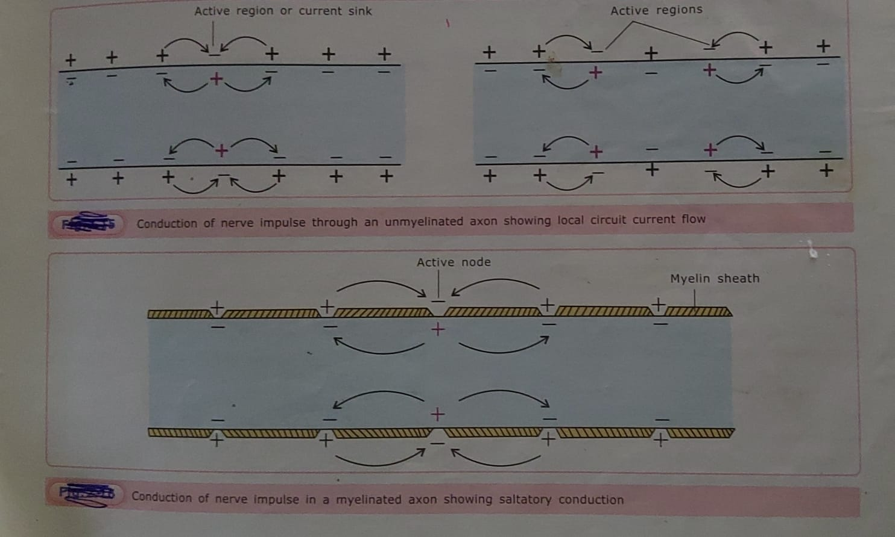

Slide 11
ASCENDING TRACTS
SENSORY TRACTS
1.LISSAUER’S TRACT-----PAIN AND TEMPERATURE
2. LATERAL SPINOTHALAMIC TRACT--- PAIN /TEMPERATURE
3. ANTERIOR/VENTRAL SPINOTHALAMIC TRACT--- PRESSURE/DEEP TOUCH
4.SPINORETICULAR TRACT [ ARAS]-- SLOW PAIN AND ALERTNESS
5. DORSAL COLUMN TRACT[FASCICULUS GRACILIS & FASCICULUS CUNEATUS/
TRACT OF GOLL& BURDACH]---- FINE TOUCH, TACTILE LOCALISATION & DISCRIMINATION
NONSENSORY TRACTS
1. SPINOCEREBELLAR TRACTS[ DORSAL/POSTERIOR&ANTERIOR /VENTRAL]--- MUSCLE TONE & COORDINATE
MOVEMENTS
2. SPINOTECTAL TRACT--- SPINOVISUAL RELEX
3. SPINO OLIVARY TRACT—NO SIGNIFICANT FUNCTION

Slide 12
Extrapyramidal tracts
Background tone posture and equilibrium .
Arise from subcortical structures like basal ganglia, brain stem, reticular formation , red nucleus, pretectal nucleus, vestibular nucleus and olivary nucleus.
Reticular formation form the relay and integrating center.
The extrapyramidal tracts are
Reticulospinal tract– Regulates muscle tone
Vestibulospinal tract– Facilitates extensor group of muscles
Rubrospinal tract--- Facilitates flexor group of muscles.
Olivo-spinal tract--- Function not known
Tectospinal tract– Reflex neck movements in response to visual stimuli[spino-visual reflex]
Medial longitudinal bundle--- co-ordinate neck movements with eye movements[both voluntary and reflex movements]

Slide 13
VISCERAL PAIN
Normally the viscera are insensitive to various forms of stimuli. If there is an inflammation of viscera there is diffused pain. It is poorly localized
CAUSES OF VISCERAL PAIN
1. Inflammation-eg Appendicitis, pancreatitis.
2.Distension-eg stone in ureter, bile duct
3.Cramping pain-eg dysmenorrhea, labor pain.
4.Chemical damage e.g.– peptic ulcer
5.Spasm of smooth muscle e.g.-intestinal colic
PATHWAY OF VISCERAL PAIN
Trachea, pharynx and esophagus– carried by vagus and glossopharyngeal nerve
THORAX – carried by sympathetic fibers of T1 to L2 segments
PELVIC ORGANS-Carried by sacral parasympathetic fibers.
When enter CNS the afferent fibers are carried by somatic ascending tracts
FEATURES OF VTSCERAL PAIN
Less localized and more diffuse.
Unpleasant and severe

Slide 14
Associated with autonomic manifestations like nausea, vomiting etc.
Visceral pain cause reflex contraction of nearby skeletal muscle known as guarding.
Is not localized but felt in a somatic structure away from the local site [referred pain]
Spreads from local site to the referred area[ Radiating pain]

Slide 15
REFERRED PAIN
Pain which occur in a visceral organ can be felt in a superficial somatic area at a considerable distance belonging to same dermatome.
Example-
1. pain in heart is felt on left shoulder tip ,radiating to finger tips.
2. pain from diaphragm is referred to right shoulder tip.
3. pain in appendicitis is felt around the skin of umbilicus.
4. Maxillary sinus pain is referred to nearby tooth.
DERMATOMAL RULE
Pain is referred to a superficial structure that has developed from the same embryonic structure from which the organ has developed.
Organ from which pain originates and the organ to which pain get referred belong to the same embryonic segment.

Slide 16
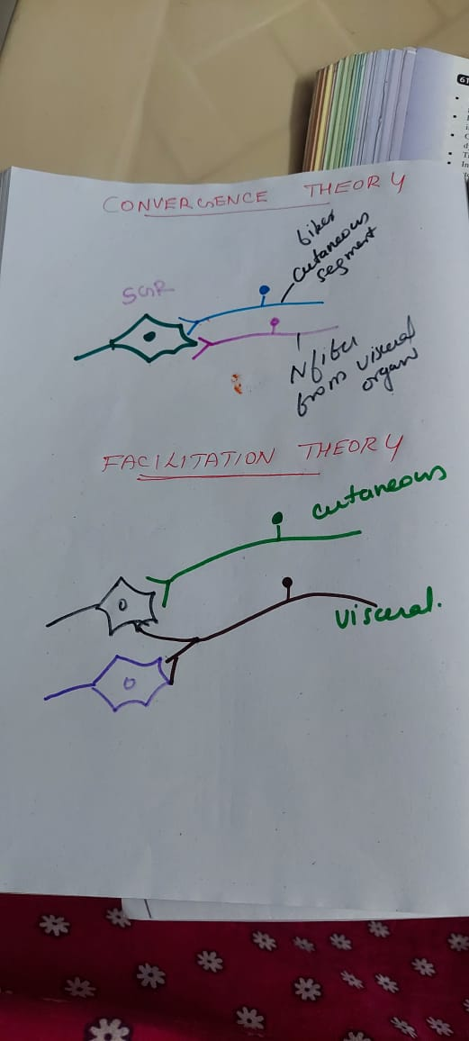
THEORIES WHICH EXPLAINS PAIN MECHANISM
CONVERGENCE THEORY &facilitation theory

Slide 17
BRODMANN’S AREAS
FRONTAL LOBE AREAS
Area 4- PRIMARY MOTOR AREA[ Initiate voluntary movements of opposite half of the body ]
Area 6– PREMOTOR AREA [Smooth and accurate skilled movements]
Area 8– FRONTAL EYE FIELD[Conjugate deviation of eye balls]
Area 44---BROCAS SPEECH AREA[ Controls motor activities of speech][left cerebral hemisphere in right handed individual]
Area 9 to 14, 23,24,29,32,35,45,46,47--- PREFRONTAL/ORBITOFRONTAL CORTEX[ [control thought, memory, ability to concentrate, elaborate thought, cultured or polished behavior, autonomic functions etc. ]
PARIETAL LOBE
Area 3,1 &2—PRIMARY SENSORY AREA [appreciation of all somatic sensations]
Area 5&7--- SENSORY ASSOCIATION AREA[understanding and analysis of sensations]
OCCIPITAL LOBE
Area 17,18&19--- Visual areas[ perceive and interpret visual stimuli]
Area 41,42 &22– Auditory areas[perceive and discriminate auditory stimuli]

Slide 18
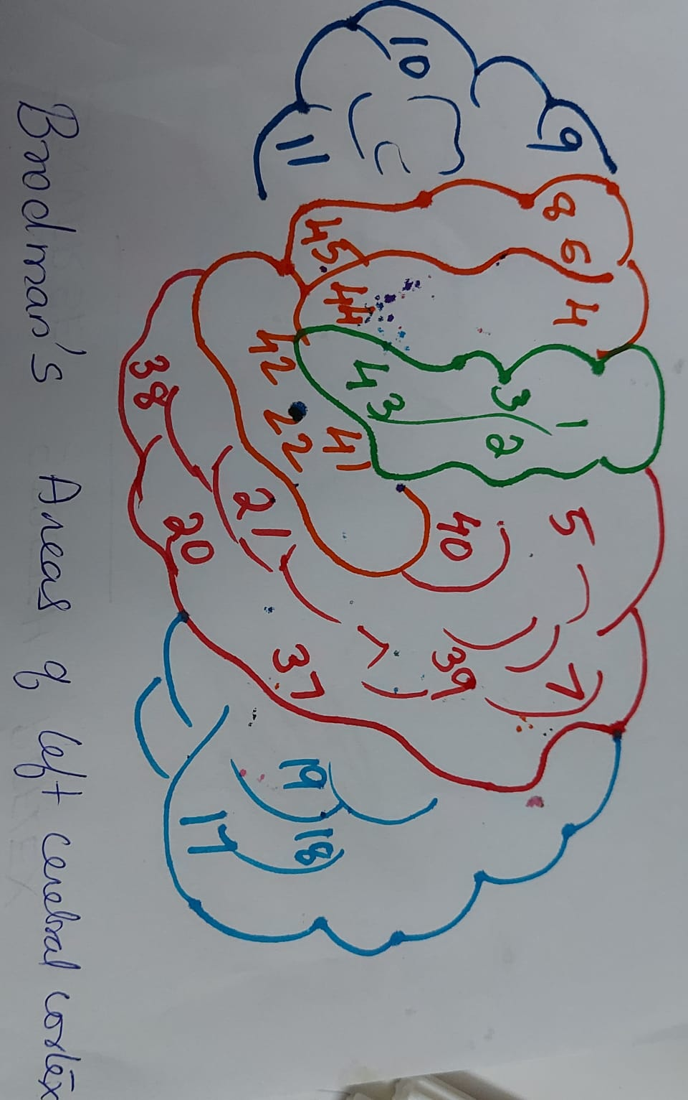

Slide 19
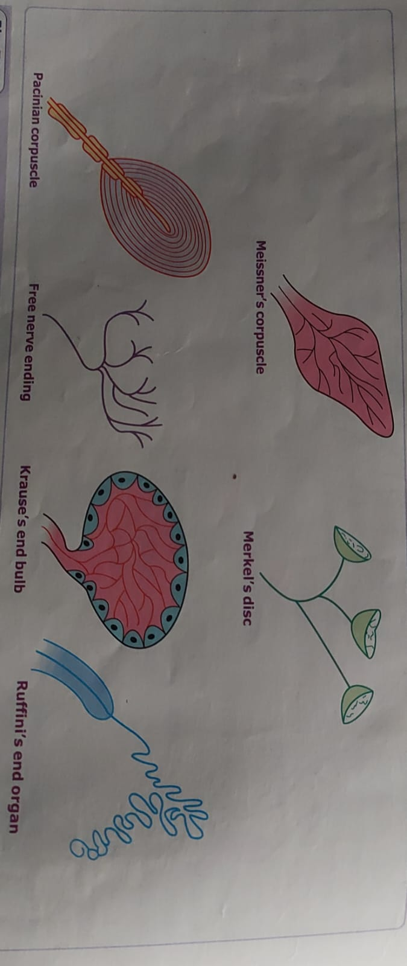

Slide 20
HYPOTHALAMUS
1. ROLE IN THERMOREGULATION---
ANTERIOR HYPOTHALAMUS– Heat loss center.
Posterior Hypothalamus– Heat gain center.
2. ROLE IN REGULATION OF ANTERIOR PITUITARY– Anterior pituitary secretes six hormone
HYPOTHALAMUS | ANTERIOR PITUITARY
1.GHRH[GROWTH HORMONE RELEASING HORMONE] 2.GHIH.[GROWTH HORMONE INHIBITING HORMONE] 3. TRH[THYROTROPIN RELEASING HORMONE] 4. CRH[ CORTICO TROPIN RELEASING HORMONE] 5. GnRH[GONADOTROPIN RELEASING HORMONE] 6. PRH[PROLACTIN RELEASING HORMONE] PIH[PROLACTIN INHIBITING HORMONE] | GH[ GROWTH HORMONE TSH[THYROID STIMULATING HORMONE] ACTH [ADRENOCORTICOTROPIC HORMONE] FSH[FOLLICLE STIMULATIN HORMONE] LH [LEUTENISING HORMONE] PROLACTIN

Slide 21
3. ROLE IN REGULATION OF POSTERIOR PITUITARY HORMONES—
ADH & OXYTOCIN ARE RELEASED FROM SON AND PVN OF HYPOTHALAMUS AND ARE CARRIED UPTO THE POSTERIOR PITUITARY THROUGH HYPOTHALAMO-HYPOPHYSEAL NERVE TRACT. FUNCTION OF POSTERIOR PITUITARY IS STORAGE AND RELEASE OF THESE HORMONES.
4. ROLE IN WATER BALANCE– LATERAL HYPOTHALAMUS IS INVOLVED IN THIRST MECHANISM AND BY THE RELEASE OF ADH , HYPOTHALAMUS IS INVOLVED IN WATER BALANCE OF THE BODY.
5. ROLE IN HUNGER AND SATIETY—LATERAL HYPOTHALAMUS IS INVOLVED IN HUNGER AND MEDIAN HYPOTHALAMUS IS INVOLVED IN SATIETY .
6. ROLE IN REGULATION OF AUTONOMIC NERVOUS SYSTEM—
ANTERIOR HYPOTHALAMUS STIMULATE PARASYMPATHETIC NERVOUS SYSTEM.
POSTERIOR HYPOTHALAMUS STIMULATE SYMPATHETIC NERVOUS SYSTEM
7. ROLE IN REGULATION OF GENERAL AND SEXUAL BEHAVIOUR---
THERE ARE TWO CENTRES OF HYPOTHALAMUS LIKE
REWARD CENTRE AND PUNISHMENT CENTRE. BY THE COMBINED ACTION OF THESE TWO CENTRES GENERAL BEHAVIOUR OF THE INDIVIDUAL IS DEVELOPED.
8.ROLE AS A BIOLOGICAL CLOCK— REGULATES DAILY CYCLE LIKE SLEEP –WAKE CYCLE, NORMONAL RHYTHM, MONTHLY CYCLE LIKE MENSTRUAL CYCLE.
.

Slide 22
FUNCTIONS OF CEREBELLUM
1. HELP IN CO-ORDINATION OF VOLUNTARY MOVEMENTS
2. HELPS IN EQUILIBRIUM
3.PREDICTIVE FUNCTION –PREDICT THE FUTURE POSITION OF LIMBS.
MOVEMENTS ARE MADE CORRECT AND PRECISE BY THE DAMPING ACTION OF CEREBELLUM.
4. HELPS IN ERROR DETECTION AND CORRECTION SINCE CEREBELLUM IS CONNECTED TO CEREBRAL CORTEX AND VOLUNTARY MUSCLES.
5.REGULATE RATE, RANGE ,FORCE AND DIRECTION OF MOVEMENT
6.REGULATE INVOLUNTARY MOVEMENTS LIKE KNEE JERK.
7. CAUSE HYPERTONICITY
CEREBELLAR ATAXIA-
ATAXIA-INCO-ORDINATED MOVEMENTS
HYPOTONIA
INTENSION TREMOR
DRUNKEN GAIT
PENDULLAR KNEE JERK

Slide 23
THALAMUS
RELAY CENTRE FOR SENSORY PATHWAYS LIKE FINE TOUCH, PRESSURE, PAIN AMD TEMPERATURE.
RELAY CENTRE FOR SPECIAL SENSES LIKE VISION, AUDITION. SMELL. AND TASTE.
CONNECTION WITH CEREBELLUM AND BASAL GANGLIA , IT CAN ACT AS AN INTEGRATING CENTRE FOR MOTOR ACTIVITIES
ASSOCIATION NUCLEI CONNECT THALAMUS TO DIFFERENT AREAS OF CEREBRAL CORTEX AND THALAMUS AND CORTEX TUNCTION AS SINGLE UNIT AND INTEGRATE SENSORY AND MOTOR FUNCTIONS.
HAS A ROLE IN LANGUAGE DEVELOPMENT
HELPS IN EMOTIONAL BEHAVIOUR AND RECENT MEMORY.
NONSPECIFIC PROJECTION NUCLEI FORM PART OF ARAS[ Ascending reticular activating system] and is responsible for alertness, arousal and attention of an individual.
THALAMIC SYNDROME==
1.Hemianesthesia
2.Astereognosis
3.Thalamic pain
4. Thalamic phantom limb.
5. Intention tremor

Slide 24
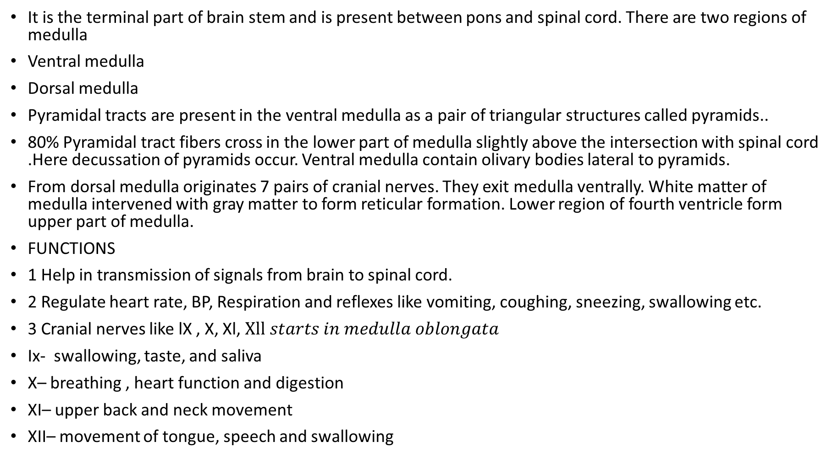
FUNCTIONS OF MEDULLA
It is the terminal part of brain stem and is present between pons and spinal cord. There are two regions of medulla
Ventral medulla
Dorsal medulla
Pyramidal tracts are present in the ventral medulla as a pair of triangular structures called pyramids..
80% Pyramidal tract fibers cross in the lower part of medulla slightly above the intersection with spinal cord .Here decussation of pyramids occur. Ventral medulla contain olivary bodies lateral to pyramids.
From dorsal medulla originates 7 pairs of cranial nerves. They exit medulla ventrally. White matter of medulla intervened with gray matter to form reticular formation. Lower region of fourth ventricle form upper part of medulla.
FUNCTIONS
1 Help in transmission of signals from brain to spinal cord.
2 Regulate heart rate, BP, Respiration and reflexes like vomiting, coughing, sneezing, swallowing etc.
3 Cranial nerves like lX , X, Xl, $Xll starts in medulla oblongata$
Ix- swallowing, taste, and saliva
X– breathing , heart function and digestion
XI– upper back and neck movement
XII– movement of tongue, speech and swallowing

Slide 25
In medulla gray matter and white matter intermingled and form reticular formation. Neurons of reticular formation help to transmit motor and sensory information.
Neurons in the medulla control autonomic nervous activity, regulate respiration, , digestive system.
Other important functions are control of movement, relay of somatic sensory information from internal organs, and control of sleep and wakefulness.

Slide 26
FUNCTIONS OF PONS
It is present in between the mid brain and medulla oblongata. It functions as a center which relay signals between lower cerebellum, spinal cord, midbrain, cerebrum and other higher parts of brain.
FUNCTIONS
1 Help to transfer signals between cerebellum and motor cortex[cerebrum]
2 Sensation and motor function of head and neck
3 Controls the rate and depth of respiration.
4 Involved in controlling sleep cycles, alertness, pain responses and help in body’s fight or flight system.
4. Responsible for rapid eye movement during sleep.
5 Cranial nerves which arise from pons focus on motor response, eye and facial movements.[v, vi, vii and viii cranial nerves ]
V Cranial nerve – Help in chewing and also sensation from face.
VI Cranial nerve– help in eye movement outward and away from nose.
VII Cranial nerve– Help in taste and swallowing and also facial movement and expressions
VIII Cranial nerve- Help in equilibrium and hearing.

Slide 27
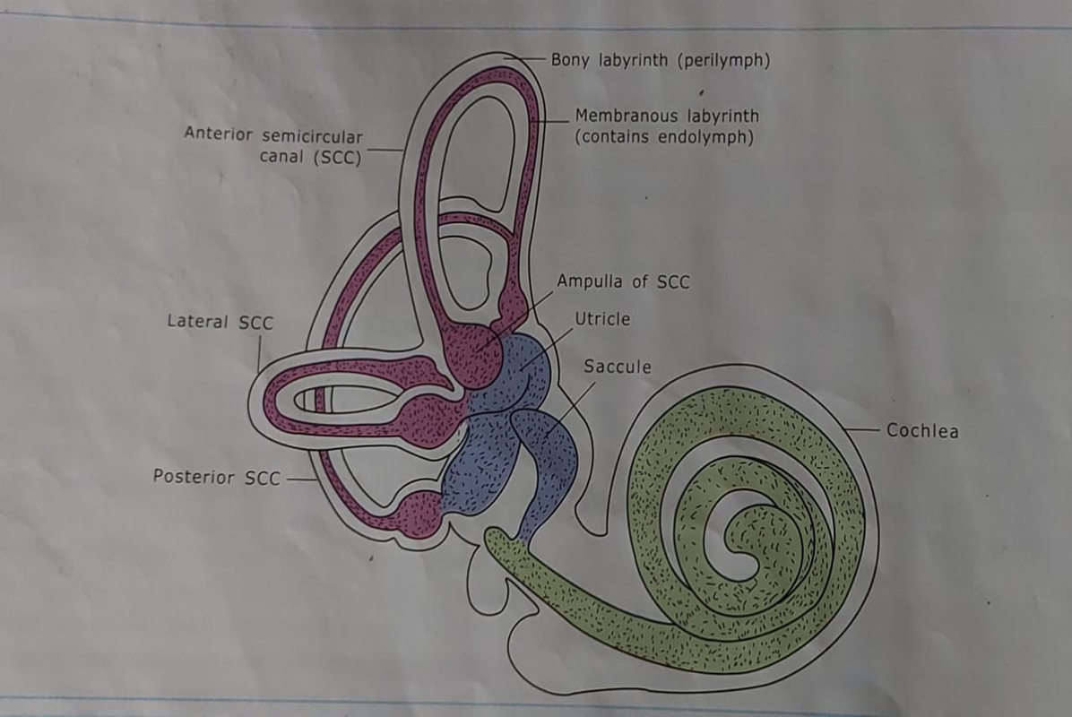
VESTIBULAR APPARATUS

Slide 28
VESTIBULAR APPARATUS
It is the sense organ for the sensation of equilibrium. The membranous labyrinth is the functional part of the vestibular apparatus. It consists of
1.Three semicircular canals
2. The otolith organs are saccule and utricle.
SEMICIRCULAR CANAL
Semicircular canals are the tubular structures placed at right angles to each other. Because of this type of arrangement, the
Semicircular canals represent the three axis of rotation ; horizontal[lateral], superior[anterior] and inferior[posterior].
They contain endolymph and are separated from bony canal by perilymph. Each canal begins as a dilation containing a projecting ridge called crista ampullaris. Each crista ampullaris contain hair cells and supporting cells surrounded by a gelatinous partition [cupula] that closes off the ampulla. The process of hair cells are embedded in the cupula and the base of hair cells are in contact with afferent fibers of the vestibular division of vestibulo- cochlear nerve.
The utricle and saccule contain macula [receptor in otolith organ]. Macula is formed of hair cells and supporting cells. A large non motile hair called Kino cilium and the remaining hair cells are called stercocilia, are small cilia which increase in their height. The cupula contain fine chalky calcium carbonate crystals otoliths. Hairs plus gelatinous material containing calcium carbonate is called as otolith membrane.
When head is in the normal erect position
Macula of each utricle is in the horizontal plane.
Macula of each saccule is in the vertical plane.

Slide 29
FUNCTIONS
Otolith organ in utricle and saccule is stimulated by gravity and semicircular canals activated by rotational activity.
It helps in erect position of head with respect to trunk.
Helps to recognize position and movements of the head and allows visual fixation on moving objects.
FUNCTIONING OF VESTIBULAR APPARATUS
Utricle and Saccule provide information about linear acceleration and position of head with respect to gravity.
Macula of utricle is held horizontally so utricle respond to horizontal acceleration[as in travelling in a car] and Macula of saccule is held vertically so saccule responds to vertical acceleration[as in travelling in lift]. The maculae of both are stretch receptors. Based on bending the head [sideways or Ventro-dorsal ]gravity acts. Saccule is stimulated when there is sideways flexion [right or left] Utricle is stimulated when there is ventral or dorsiflexion of head.
FUNCTIONING OF SEMICIRCULAR CANALS
The semicircular canals detects angular acceleration. When a person rotates in clockwise direction, in the right semicircular canal endolymph move towards ampulla[stimulation], while in left semicircular canal endolymph move away from ampulla[not stimulated]. Because of stimulation the hair cells in the right horizontal canal send information through sensory nerves to vestibular, cerebellar and reticular centers. Now these centers send proper instructions to muscles of the body to maintain equilibrium. Rotation in anticlockwise direction cause stimulation of hair cells in the ampulla of horizontal canal in the left ear only.
ROLE IN REGULATION OF POSTURE
1.The tract that descends from vestibular nuclei into spinal cord maintains tone in antigravity muscle and coordinates the adjustments made by the limbs and eyes in response to change in body position. The vestibular apparatus help in support of head during movements, orientation of head in space and in tonic reflexes [accompanying locomotion labyrinthine and righting reflexes]

Slide 30
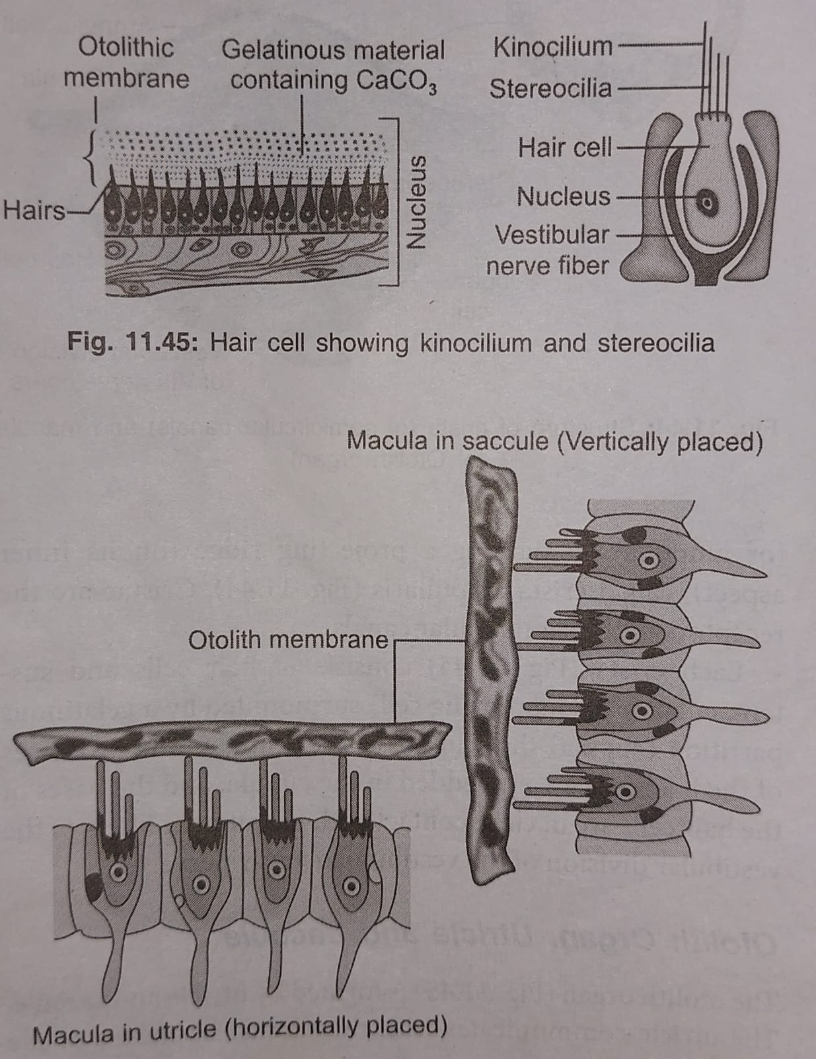

Slide 31
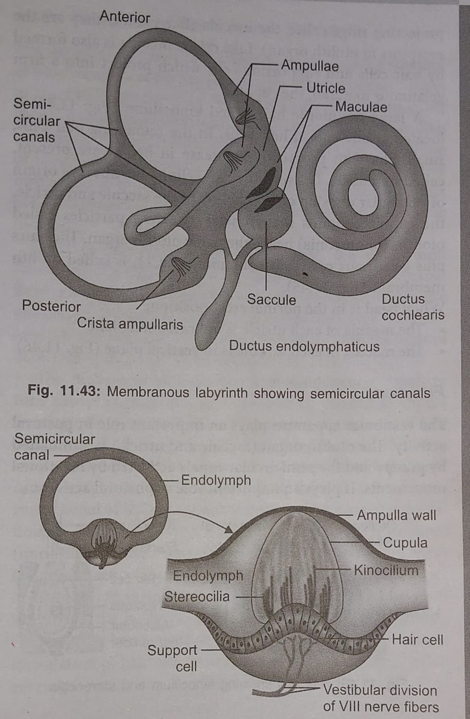

Slide 32
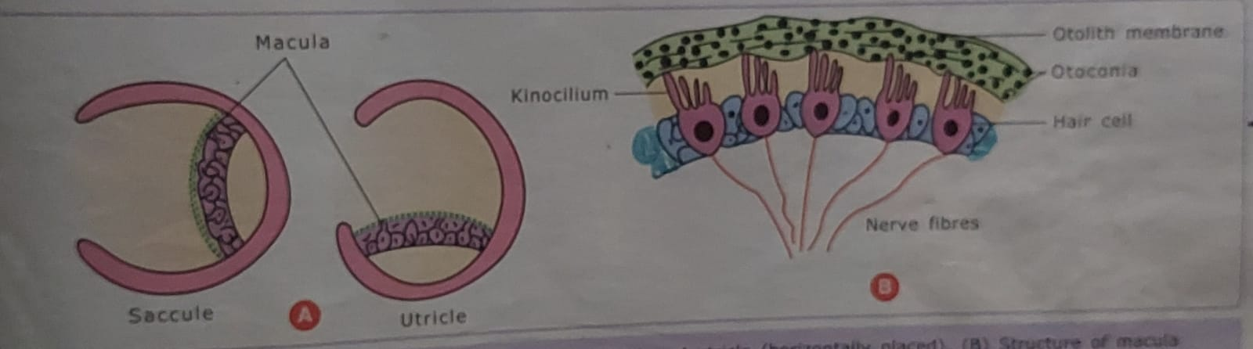
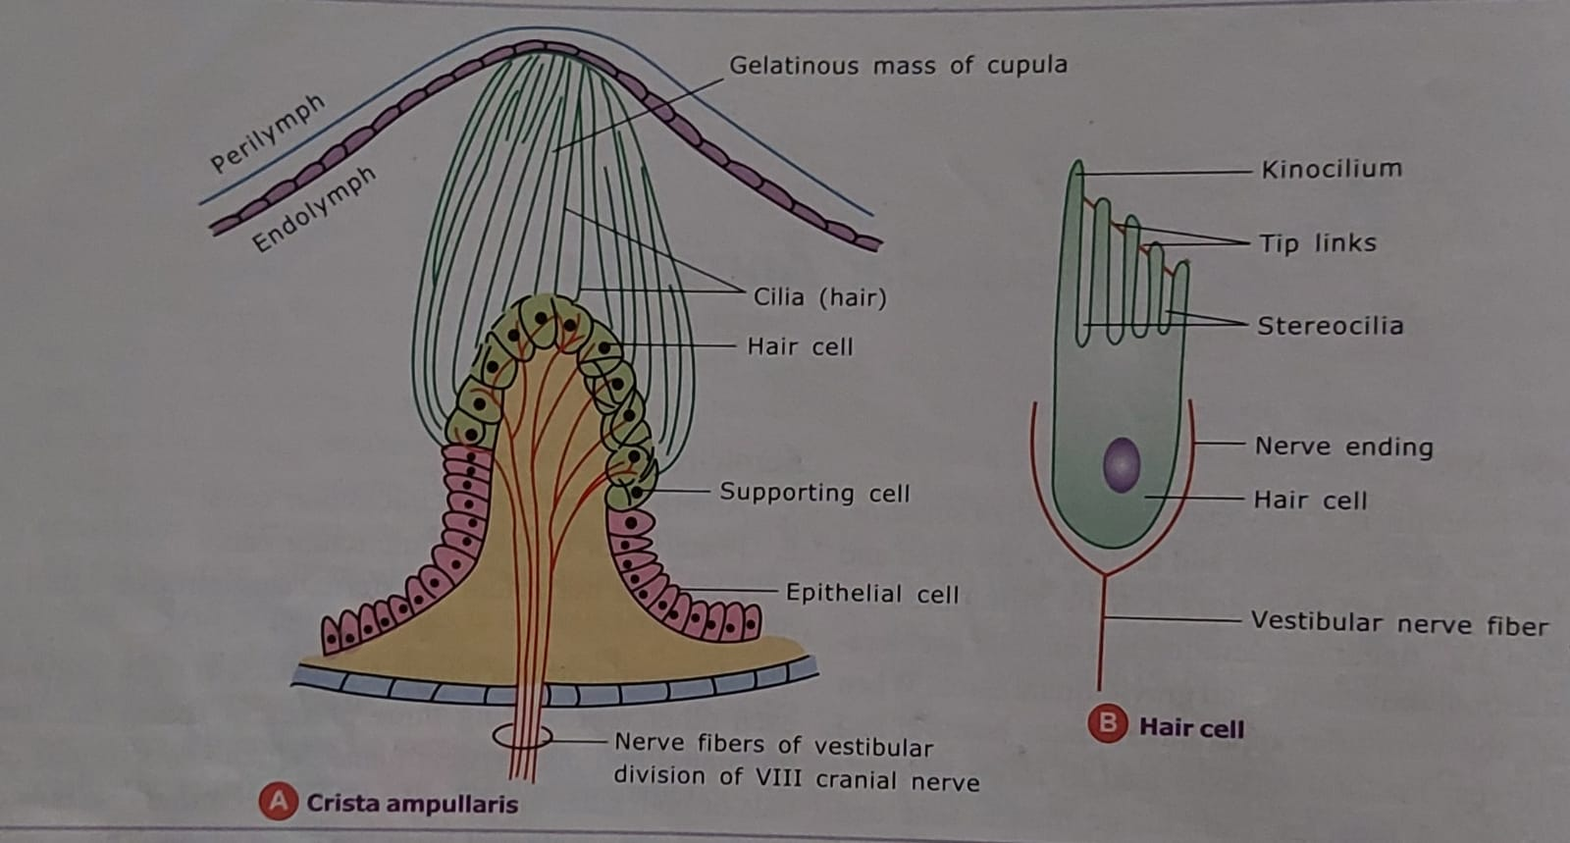
2 It regulates eye movements through ascending connections at cranial nerve nuclei. Eye can remain fixed in the same point in spite of changes in head position.[vestibule ocular reflex]
3.Orientation in space- Relative position of various body parts in space depends on four inputs.
a. From vestibular receptors
b. From visual information
c. By impulses from proprio receptors of joint capsule
d. By impulses from cutaneous extero receptors.
UTRICLE AND SACCULE SEMICIRCULAR CANAL

Slide 33
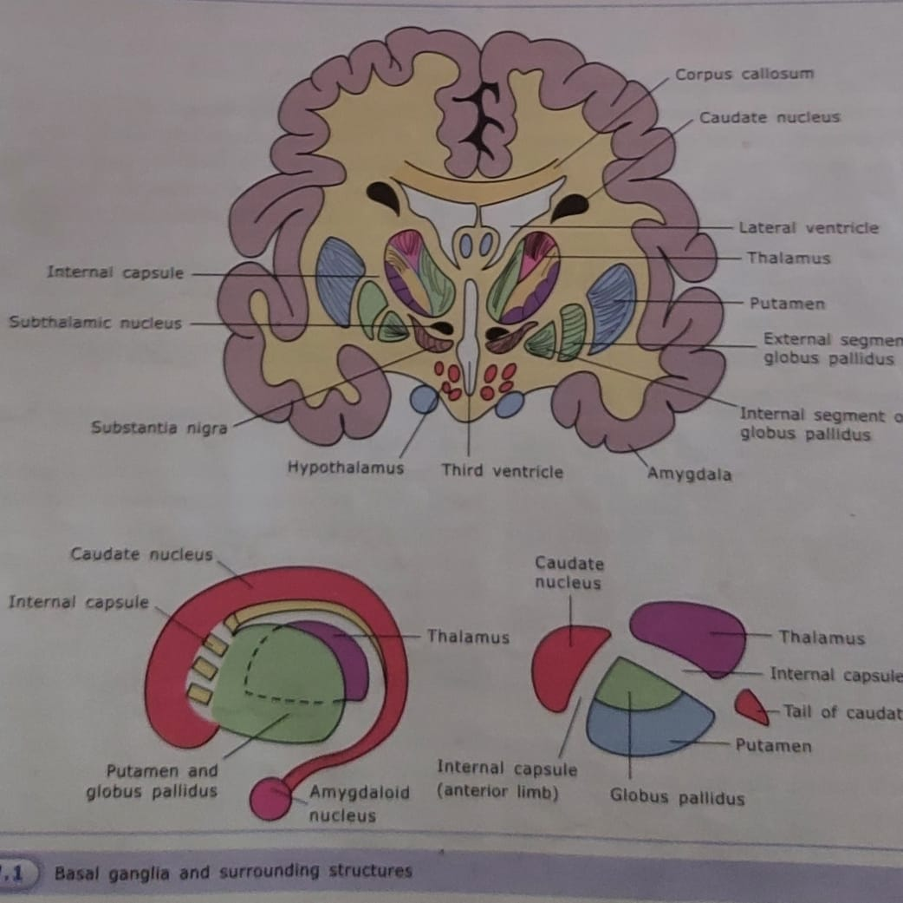

Slide 34
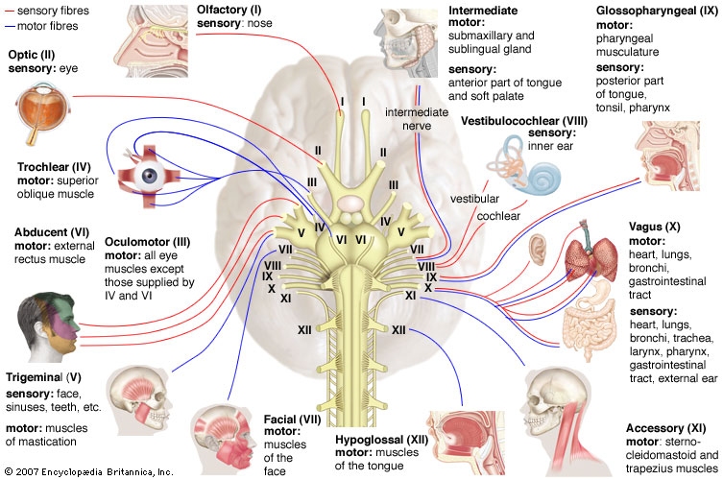

Slide 35
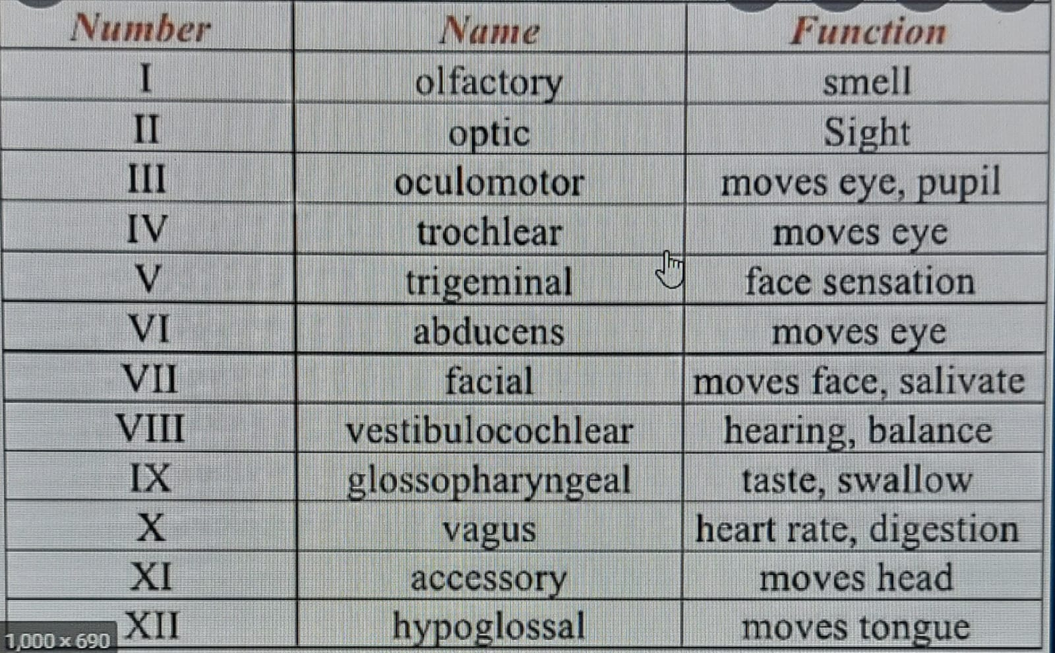

Slide 36
NEUROGLIA
FUNCTION OF ASTROCYTES—
1.Protoplasmic astrocytes support neurons in grey matter and Fibrous astrocytes support neurons in white matter.
2. Act as an insulator.
3.Help in repair of scar formation
4. Help in formation of blood brain barrier.
5. Form a route through which nutrients reach the brain tissue from blood.
FUNCTION OF OLIGODENDROCYTES---
Help in myelination of nerve fibres
FUNCTION OF MICROGLIA—
Help in phagocytosis.

Slide 37
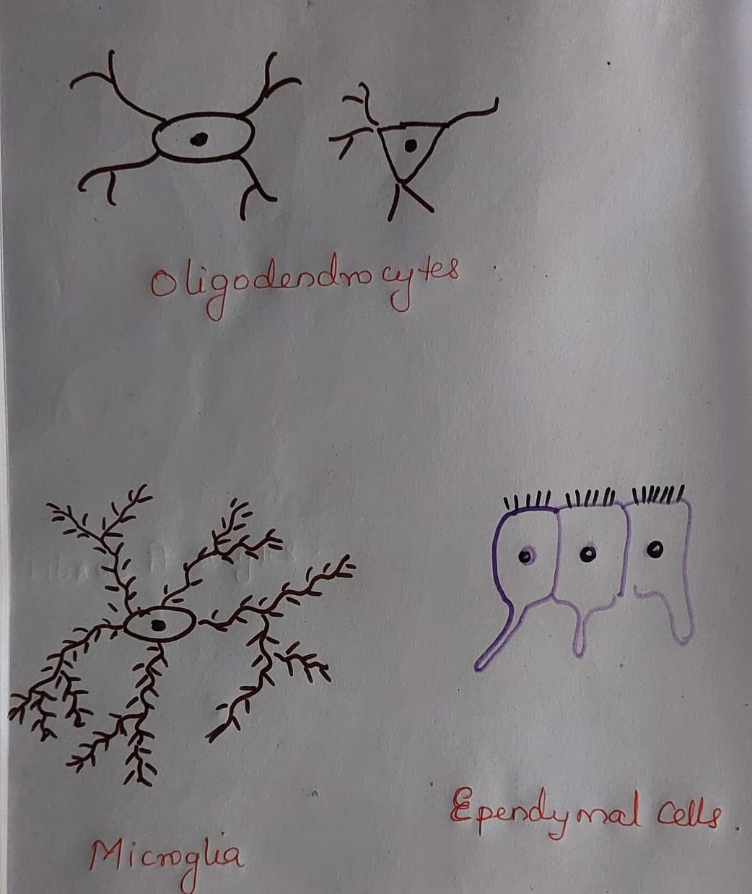
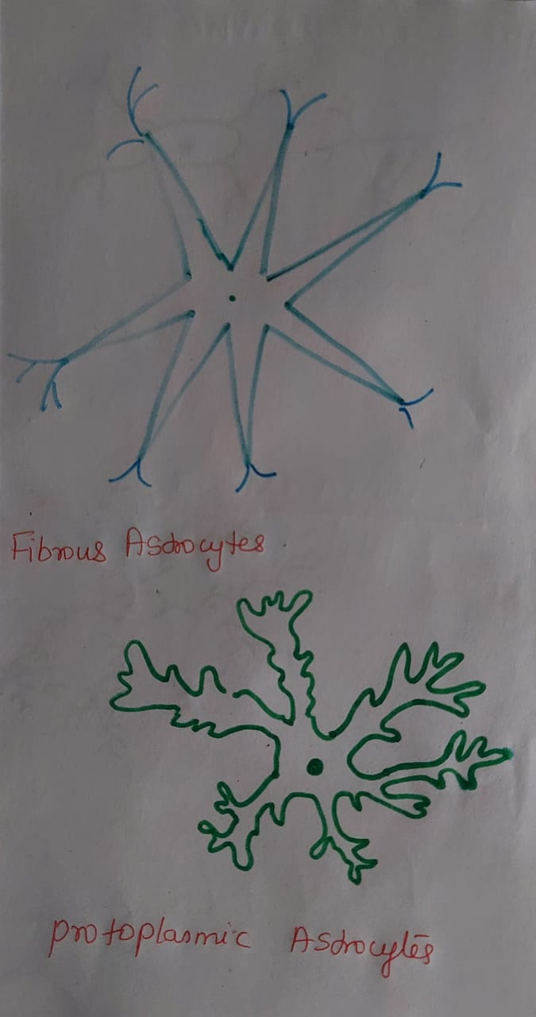

Slide 38
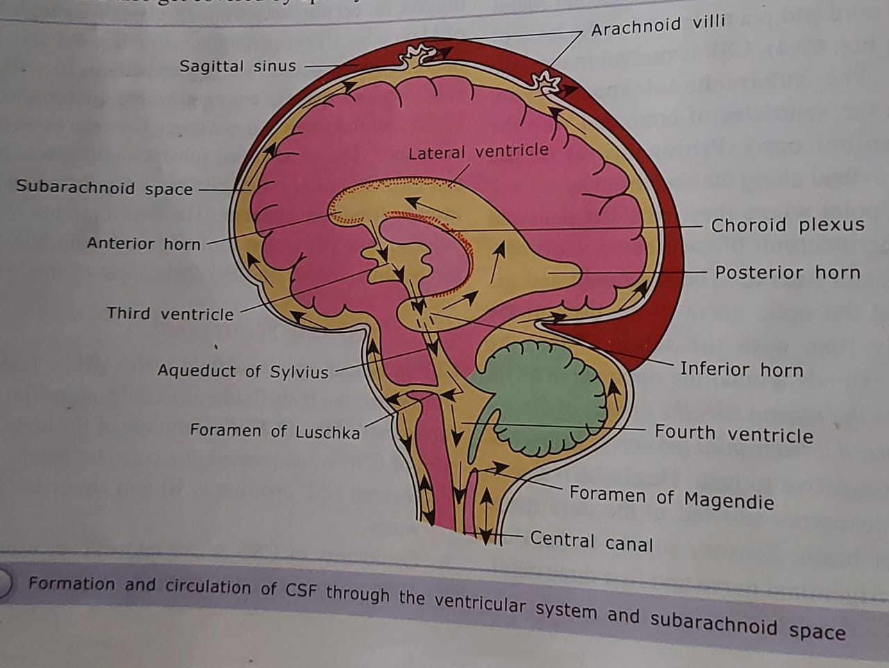

Slide 39
Composition of CSF—
Total volume-150 ml
Ph-7.35-7.4
Osmolarity-289 milliosmoles /liter
CSF pressure-10 mmHg
Rate of formation- 500-600ml/day
FORMATION OF CSF–
2/3 BY THE CHOROID PLEXUS, EPENDYMAL CELLS AND BRAIN TISSUE
CIRCULATION OF CSF
LATERAL VENTRICLE
FORAMEN OF MONRO
THIRD VENTRICLE
AQUEDUCT OF SYLVIUS
FOURTH VENTRICLE
FORAMEN OF LUSCHKA FORAMEN OF MAGENDIE
CENTRAL CANAL OF SPINAL CORD AND SUB ARACHNOID SPACE

Slide 40
FUNCTIONS OF CSF
1.CSF acts as a cushion and protects the brain
Specific gravity of brain and CSF is the same so brain floats in the CSF. When a severe hit occur in any part of the head , CSF move towards the direction of hit and brain move in the opposite direction and injury can occur in the opposite part of the brain . This is known as contre- coup injury.
It act as a reservoir and regulate the intracranial volume and pressure
Nourishes the brain
Remove metabolites from brain
Form the route through which pineal secretions the anterior pituitary
Help to return proteins from brain interstitial space to CSF and then to Dural venous sinuses.

Slide 41
BLOOD -BRAIN BARRIER AND BLOOD- CSFBARRIER
Blood brain barrier is present in all areas of brain except hypothalamus. Hypothalamus help in maintaining homeostasis and so it is outside the BBB. BBB is permeable to lipid soluble substances and impermeable to plasma proteins.
Tight junctions between endothelial cells of the capillaries, presence of basement membrane outside endothelial cells, foot process of protoplasmic astrocytes outside capillary wall etc. are contributing to the formation of BBB.
Regions of brain outside blood brain barrier are posterior lobe of pituitary, median eminence of hypothalamus, tuber cinereum, sub fornical organ, vascular area postrema.
Blood –CSF barrier is present in the choroid plexus as tight junctions between the choroid epithelial cells
FUNCTIONS.
1 Protects brain and spinal cord from harmful substances in blood and also allow nutrients and gases to enter brain tissue.
2 maintain a suitable environment for brain tissues. Maintain low potassium level for the development of high electrical potential.
3 Substances present in CSF like drugs can easily diffuse into brain tissue.
4 Prevent diffusion of neurotransmitters from brain into blood circulation

Slide 42
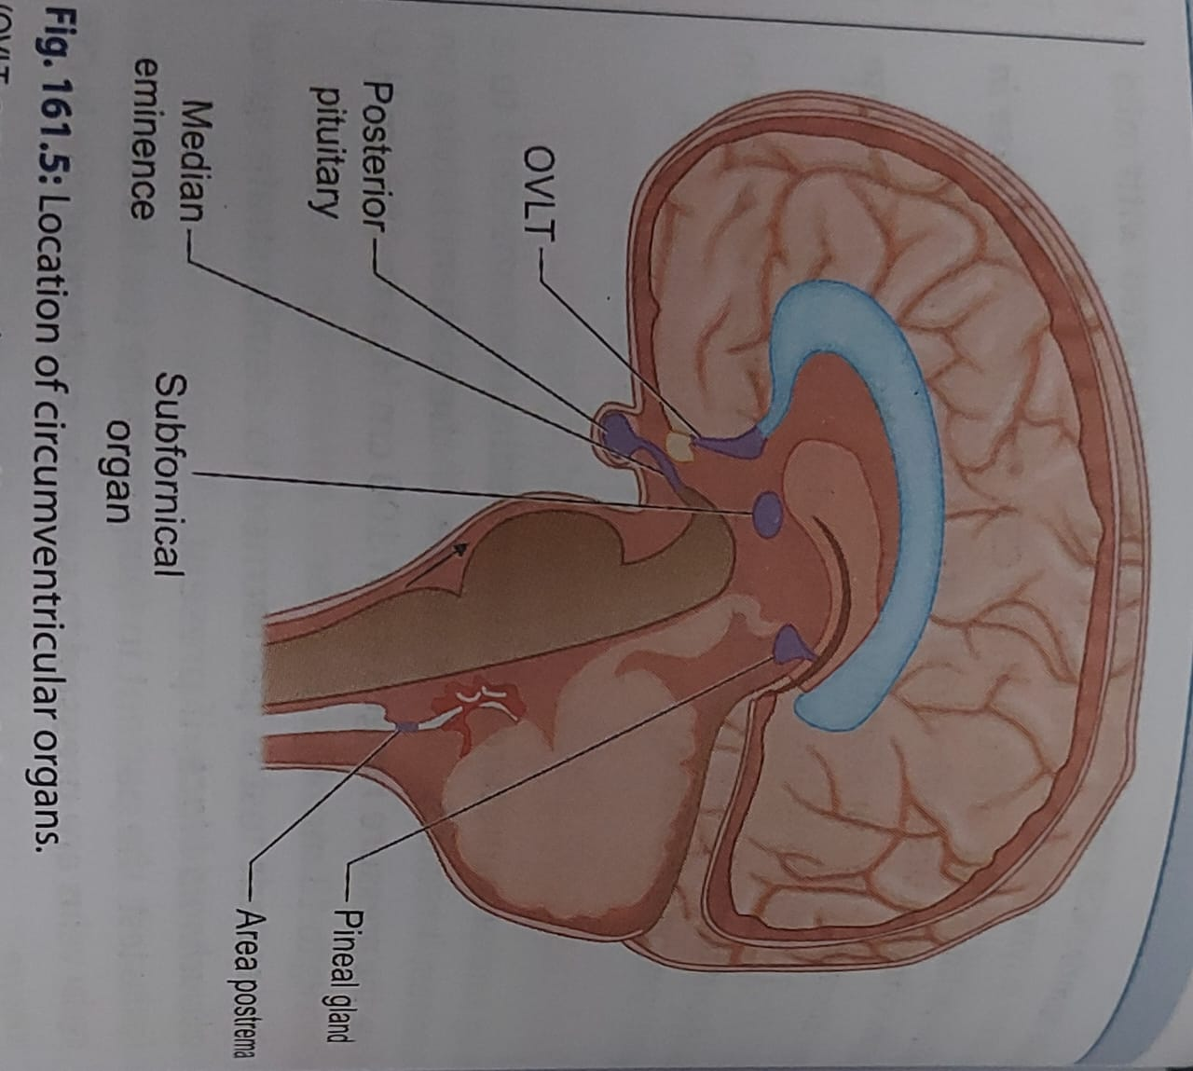

Slide 43
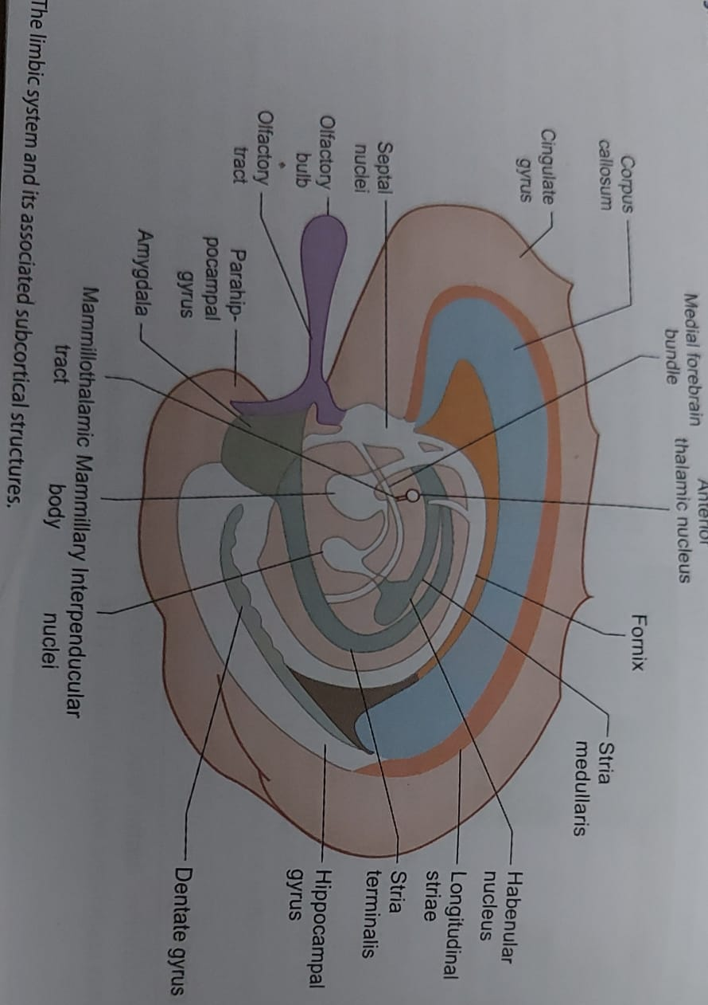

Slide 44
FUNCTIONS OF LIMBIC SYSTEM
1 REGULATION OF FEEDING BEHAVIOUR
Stimulation of hunger and thirst cause food and water intake. Stimulation of limbic cortex result in satisfaction.
2 REGULATION OF SOMATIC RESPONSE
Stimulation of limbic cortex produce somatic response in facial muscle for facial expression[emotional expression]
3 REGULATION OF SEXUAL BEHAVIOUR
Sexual behavior is controlled by limbic system and hypothalamus. Normal sexual behavior is influenced by gonadal hormones and cerebral cortex.
4. MATERNAL BEHAVIOUR
Cingulate gyrus is concerned with breast feeding and protection of offspring. Oxytocin and prolactin help in maternal behavior.
5.ROLE IN CONSCIOUSNESS, MEMORY AND EMOTIONS
Consciousness is the simultaneous awareness of self and the environment by limbic system. Memory is the ability to recall an event or thought again and again. Recent memory is the function of hippocampus and amygdala. Hippocampus can convert recent memory into long term memory. Limbic system and Hypothalamus regulate emotional behavior.

Slide 45
SYMPATHETIC AND PARASYMPATHETICNERVOUSSYSTEM
SYMPATHETIC NERVOUS SYSTEM | PARASYMPATHETIC NERVOUS SYSTEM
CELLBODIES OF PREGANGLIONIC NEURONS ARE PRESENT IN T₁ TO L₂ SEGMENTS OF SPINAL CORD 2. PREGANGLIONIC NEURON IS SHORT AND POST GANGLIONIC NEURON IS LONG 3. EFFECT IS LONG LASTING AND WIDE SPREAD 4.PREPARED THE BODY FOR EMERGENCY CONDITIONS LIKE FIGHT, FLIGHT OR FRIGHT | PRESENT IN III, VII,IX AND X CRANIAL NERVE NUCLEI AND S₂,S₃ AND S₄ SEGMENTS OF SPINAL CORD PREGANGLIONIC NEURON IS LONG AND POST GANGLIONIC NEURON IS SHORT EFFECT IS LOCALISED TO AN ORGAN /SYSTEM HELP TO CONSERVE ENERGY[ANABOLIC NERVOUS SYSTEM]

Slide 46
EFFECTS OF SYMPATHETIC AND PARASYMPATHETIC NS
EFFECT ON SYSTEMS | PARASYMPATHETIC STIMULATION | SYMPATHETIC STIMULATIONH
HEART RESPIRATRY TRACT GIT EXOCRINE GLANDS SALIVARY GLANDS BLOOD VESSELS URINARY BLADDER GALL BLADDER EYE | DECREASE IN HEART RATE BRONCHOCONSTRICTION INCREASE MOVEMENTS AND RELAXATION OF SPHINCTERS INCREASE SECRETIONS OF ALL GLANDS [EXCEPT MAMMARY GLANDS] WATERY SALIVA VASODILATION CONTRACTS DETRUSOR MUSCLE AND RELAXES UPPER URETHRAL SPHINCTER CONTRACTION CONSTRICTION OF PUPIL | INCREASEIN HEART RATE BRONCHODILATATION DECREASE MOVEMENTS AND CONSTRICTION OF SPHINCTERS DECREASE SECRETIONS OF ALL GLANDS [EXCEPT SALIVARY GLANDS] THICK AND VISCOUS SALIVA VASOCONSTRICTION RELAX DETRUSOR MUSCLE AND CONSTRICT SPHINCTER RELAXATION DILATATION OF PUPIL

